Slide 1



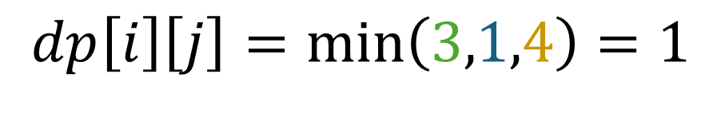
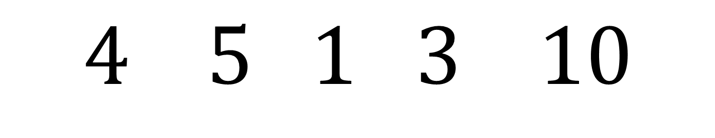
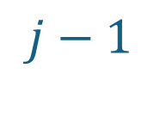

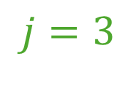



$$dp\left[i\right]\left[j\right]=\min\left(3,1,4\right)=1$$
$$\left|4−1\right|=3$$
$$i=1$$
$$j=3$$
$$4 5 1 3 10$$
$$i$$
$$j−1$$
$$\left|4−5\right|=1$$
$$i+1$$
$$j$$
$$\left|5−1\right|=4$$

Slide 2

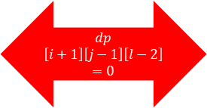
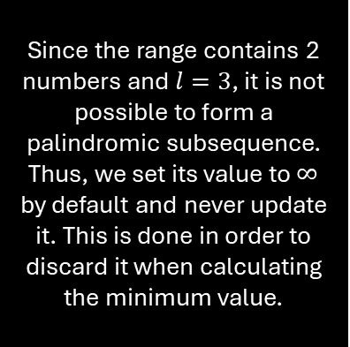


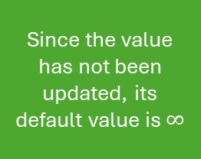
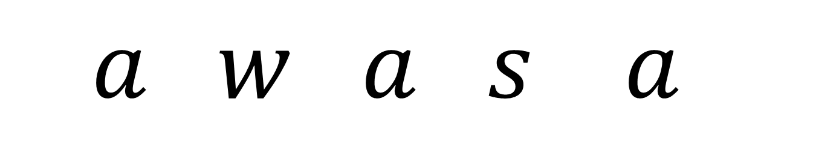
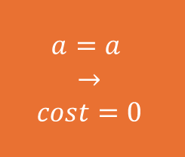
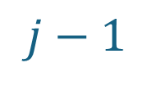

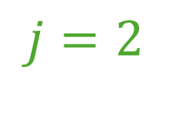

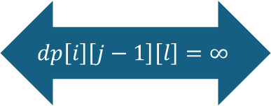
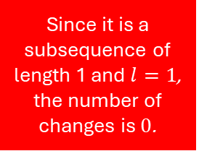



$$UPDATE→dp\left[i\right]\left[j\right][l]=\min\left(∞,0+0,∞,∞\right)=0$$
$$i=0$$
$$j=2$$
Since the value has not been updated, its default value is $∞$
$$l=3$$
$$dp\left[i\right]\left[j\right]\left[l\right]=∞$$
$$a=a$$
$$→$$
$$cost=0$$
$$j−1$$
Since it is a subsequence of length 1 and $l=1$, the number of changes is $0$.
$$dp$$
$$\left[i+1\right]\left[j−1\right]\left[l−2\right]=0$$
$$a w a s a$$
$$i$$
$$j−1$$
Since the range contains 2 numbers and $l=3$, it is not possible to form a palindromic subsequence. Thus, we set its value to $∞$ by default and never update it. This is done in order to discard it when calculating the minimum value.
$$dp\left[i\right]\left[j−1\right]\left[l\right]=∞$$
$$i+1$$
$$j$$
$$dp\left[i+1\right]\left[j\right]\left[l\right]=∞$$

